Slide 1



How to get involved in open source projects
opensourcediversity.org
@osdiversity #opensourcediversity

Slide 2
Development
Design
Documentation
Event organization
Marketing
Testing
Translation
…
Notes:
… and that leaves out plenty of people

Slide 3



Slide 4
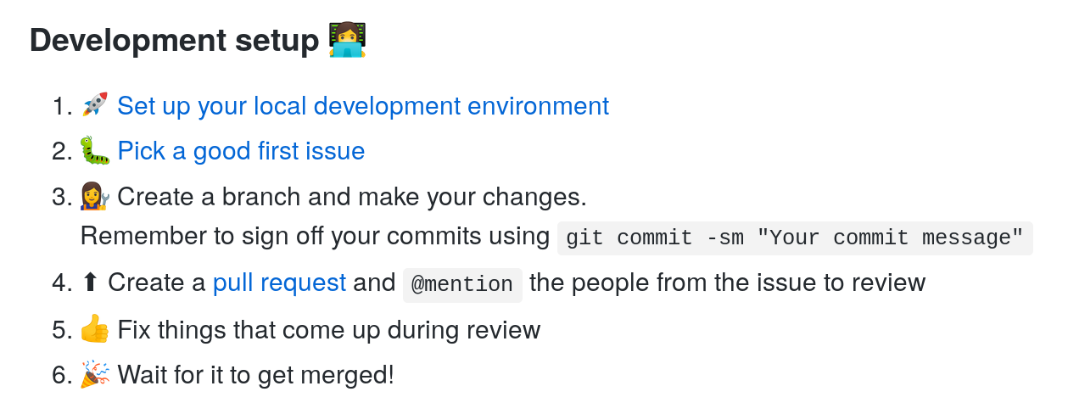

Slide 5
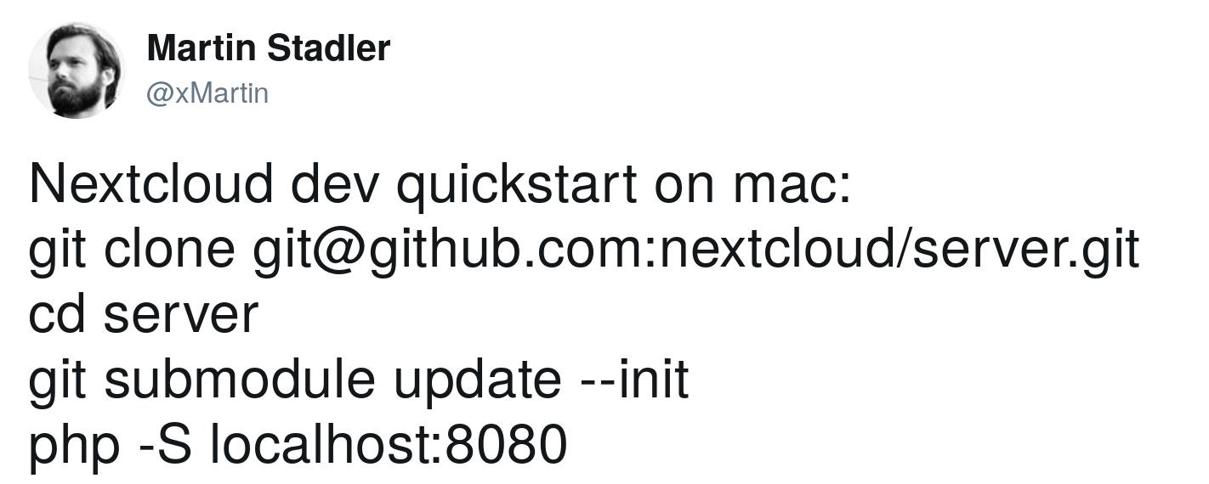


Slide 6


Slide 7
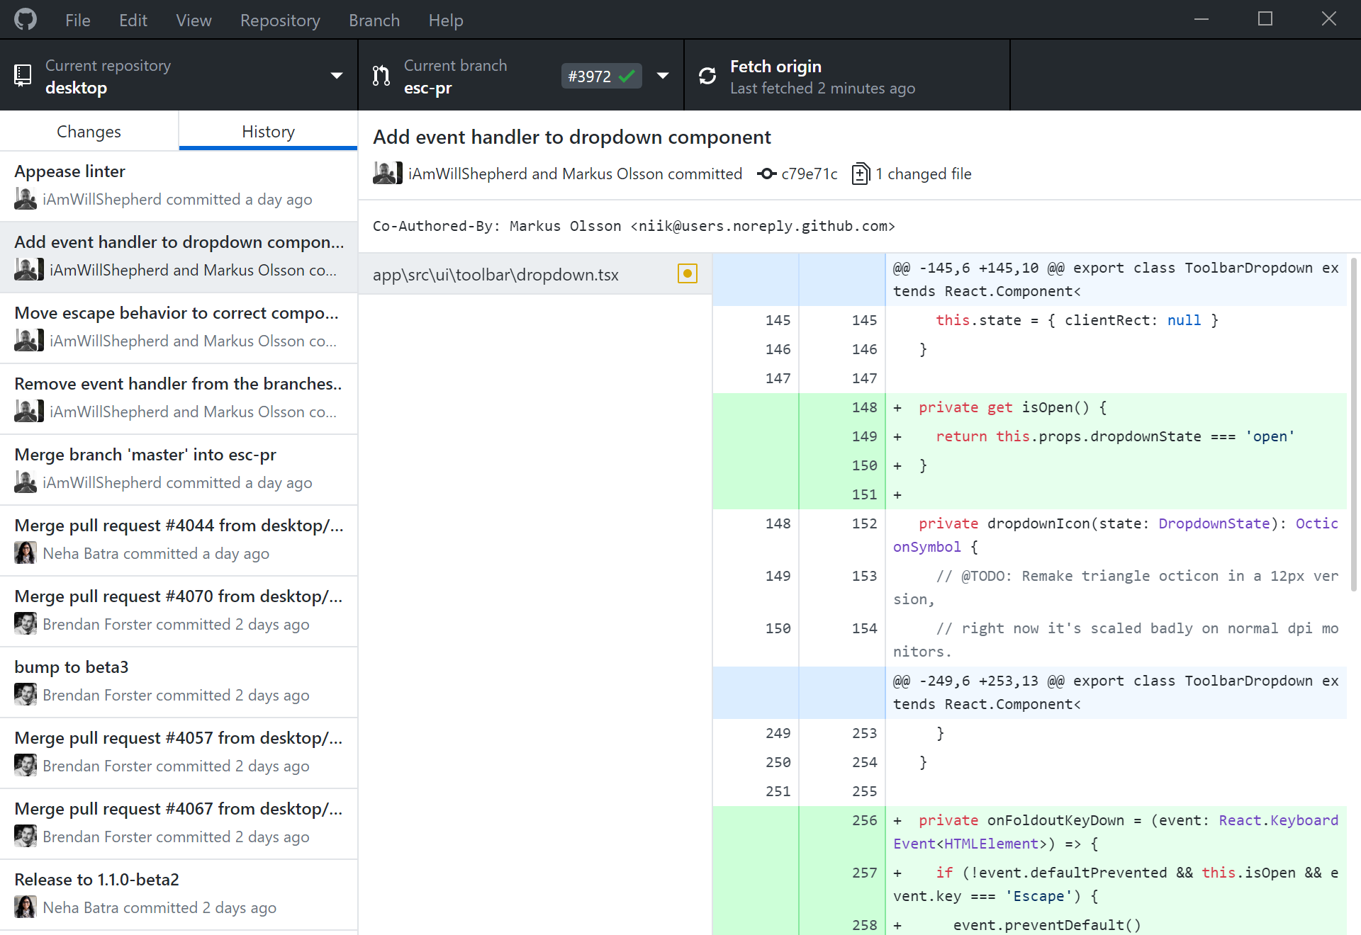

desktop.github.com

Slide 8
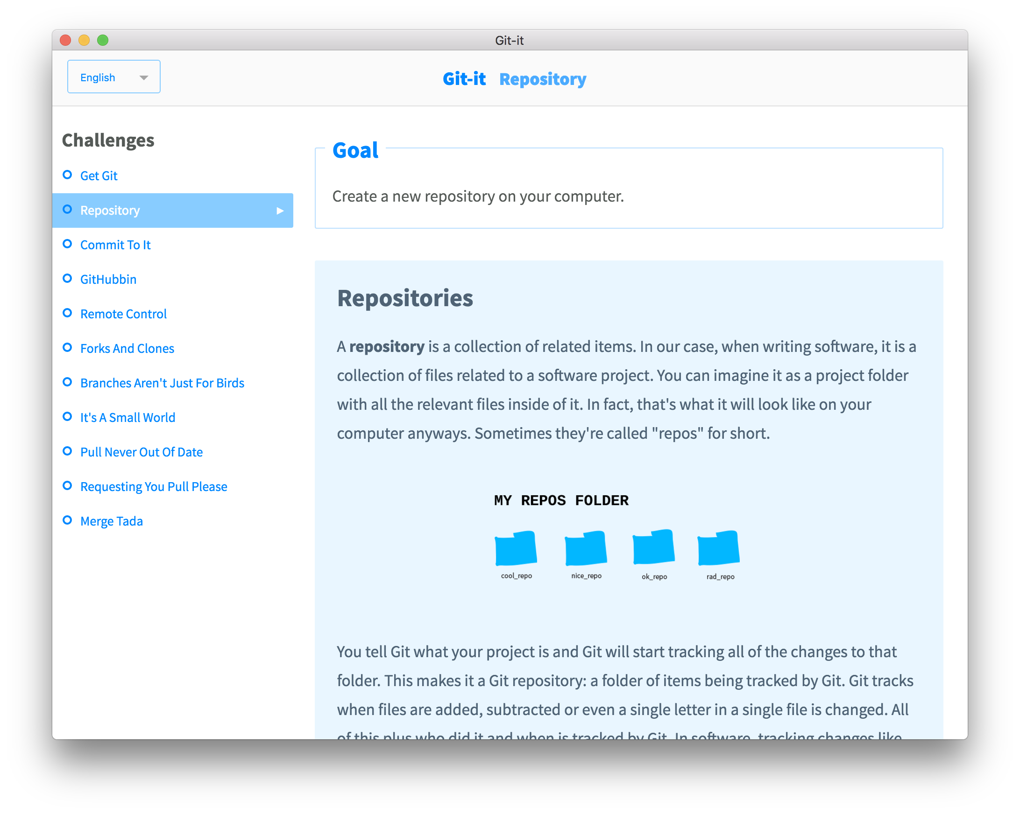

github.com/ jlord/git-it-electron
lennerd.github.io/ git-for-beginners

Slide 9
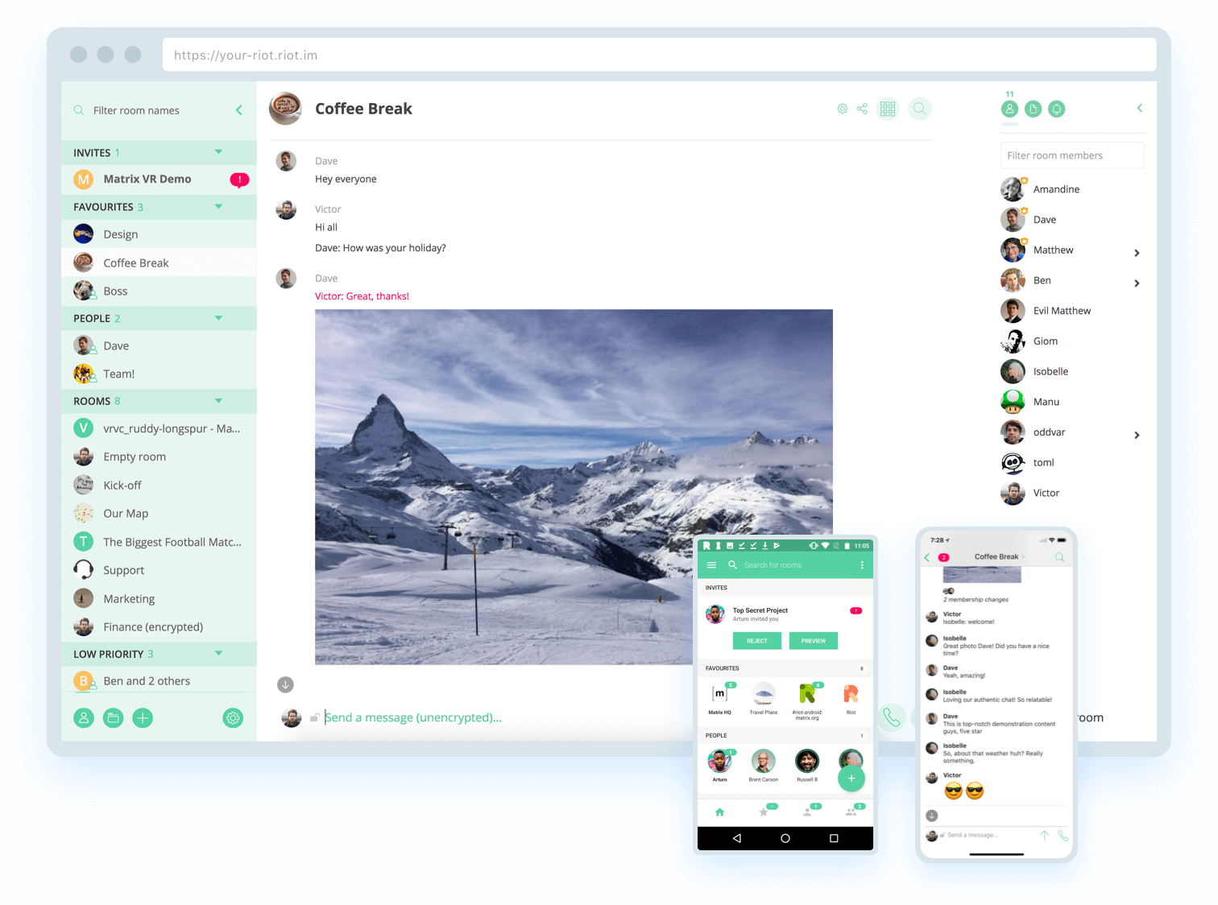

riot.im for IRC

Slide 10


Slide 11
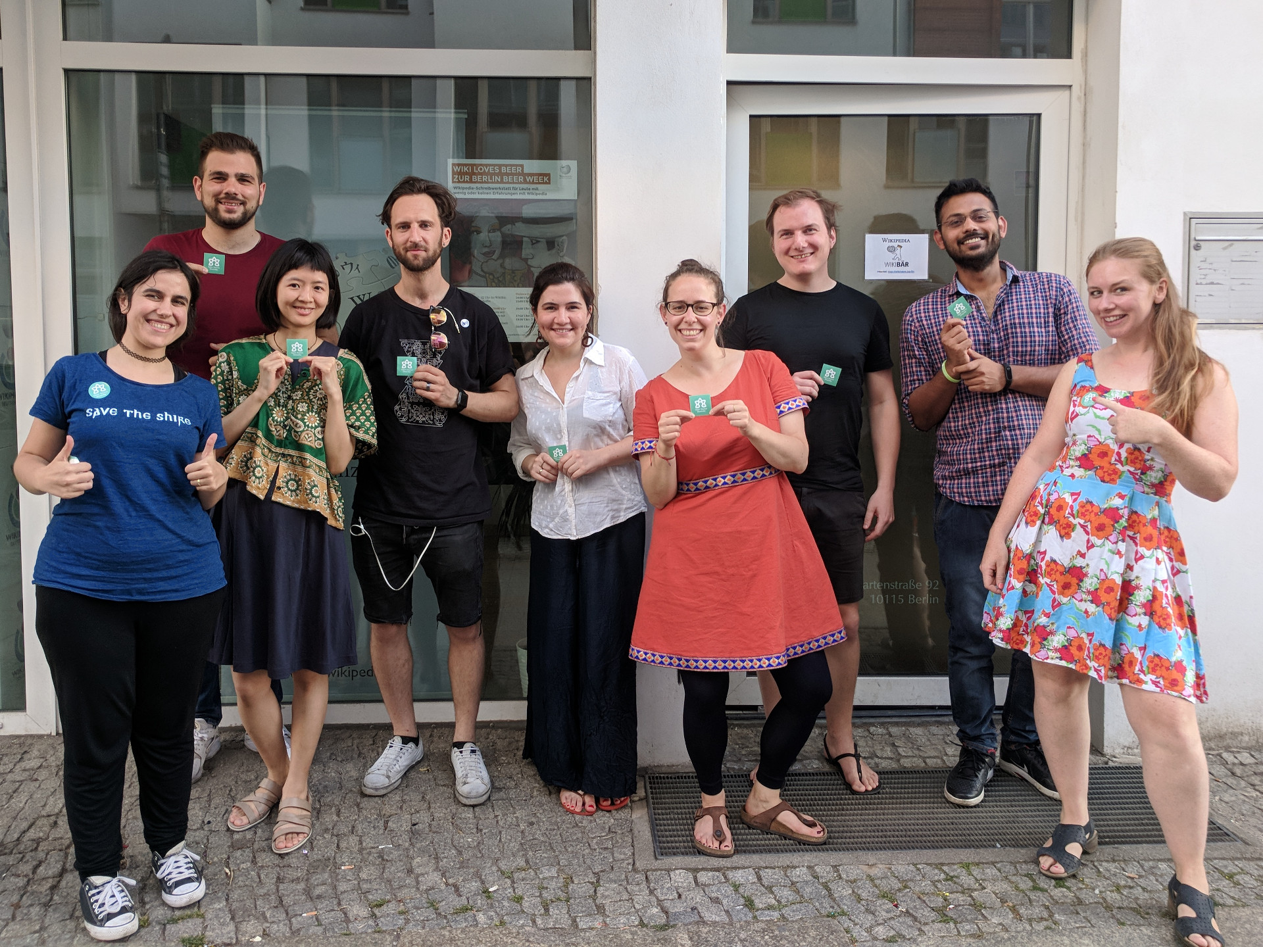

Slide 12


Slide 13
Thank you
& have fun!
opensourcediversity.org
@osdiversity #opensourcediversity

